Slide 1


Faculty of Computers & Artificial Intelligence
Benha University
Rice Diseases Diagnosis
Under The Supervision
Dr. Eman Monir

Slide 2
Aliaa Faisal AbdElmotaleb Kashwa
Team Members
Amira AbdElgany AboElmaaty Nassar
Fatma Alzahraa Mahmoud Saied
Sara Alaa Mohamed Ahmed
Sanaa Rawy Mansour Eissa

Slide 3
01
Introduction
02
Problem Statement
Agenda Style
03
Objectives
04
Project Outcomes
05
System Analysis
06
System Design
07
Future Work

Slide 4
Rice is one of the main crops that people rely on for food on a daily basis.
So rice diseases cause great damage to agriculture, and it was necessary to preserve agricultural crops from diseases that often lead to the loss of the entire crop. Annually, rice diseases destroy more than 20% of the total crop, which provides half the calories on which the world's population depends.
Among the most important diseases that affect rice plants are Brown spot disease, Hispa disease, and white Leaf blast disease.
01 Introduction

Slide 5
02 Problem Statement
A large amount of the crop yield is wasted due to the spread of diseases
01
There is no way to detect these diseases early
03
02
Lack of awareness of the type of these diseases
04
There is also a lack of awareness of modern methods of treatment among farmers.

Slide 6
03 Objectives
1. Saving a large amount of the crop early to increase the productivity of the crop and the national income returned from it, thus achieving self-sufficiency.
3. Providing a means to familiarize farmers with the common types of diseases and modern treatment methods for them constantly.
2. Providing a means for early detection of these diseases.
4. Providing an easy way for farmers to classify rice plant diseases through a mobile application.

Slide 7
04 Project Outcomes
Upload an image of the plant from the phone gallery to know its condition whether it is healthy or infected, that through showing a message under the image explaining the condition.
01
02
Knowing the type of disease in case of injury.
03
Providing him with information about available diseases.
Providing him with modern treatment methods for every disease.
04

Slide 8
05 System Analysis

Slide 9
5-1 Dataset
Size of total dataset is 12 GB
Total used 7 GB
Total number of images is 3355
Total number of train images is 2685
Total number of validation images is 670

Slide 10
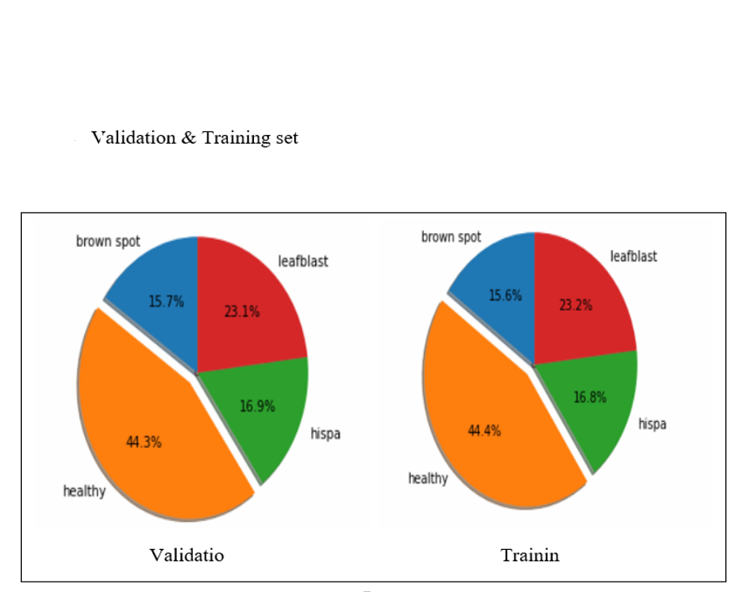
Validation Set
Training set

Slide 11
5-2 Data Augmentation
We use some transformation on images to increase their accuracy such as
HorizontalFlip
VerticalFlip
RandomContrast
RandomGamma
RandomBrightness
ElasticTransform
GridDistortion
OpticalDistortion
ShiftScaleRotate

Slide 12
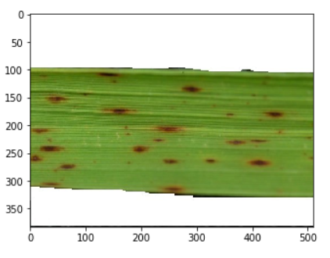
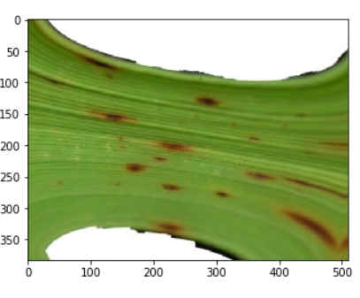
Image before data augmentation
Image after data augmentation

Slide 13
5-3 Model
Our first approach was to try out as many models as possible and pick the best performing one, and so we did. We have used several models
, including support vector machine (SVM), Artificial neural network (ANN) and Convolutional Neural Networks (CNN). Based on that,
we concluded that the (CNN) is the model with the highest accuracy among these models, for its ability to classify images in general with high accuracy.
Model | SVM | CNN | ANN
Test accuracy | 65% | 89.99% | 75%

Slide 14
5-4 MobileNet
Our project integrated MobileNet with flutter application by using tensor flow lite
Mobile Net:
CNN architecture model for image classification and mobile vision,
less computation power to run application
Suited for mobile devices, embedded system and computers without GPU.
Suited to web applications and applications in mobile device.
Used with large images and can filtration them so increase accuracy.
Tensor flow lite :
It is a set of tools that enable on-device machine learning by helping developers run their models on mobile, embedded and IoT devices.

Slide 15
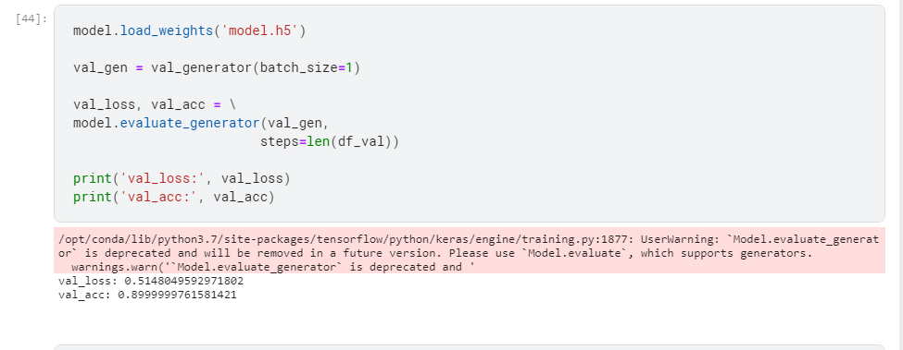
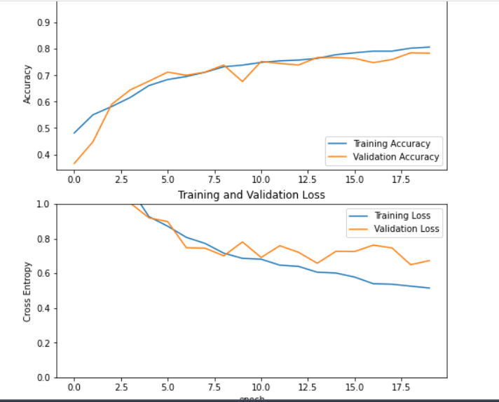

Slide 16
5-5 Flutter
Flutter is defined as the Google’s UI toolkit for building good, natively compiled applications for mobile (Android, iOS ) desktop (Linux, Mac, Windows, Google Fuchsia) and the web from a single codebasefrom a single code base by using a modern, reactive framework.
Benefits:
High productivity
Great performance
Fast and simple development
Compatibility
Open-source

Slide 17
06 System Design

Slide 18
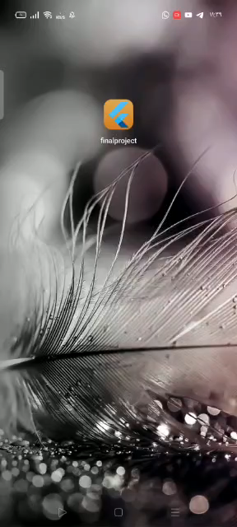
Application

Slide 19
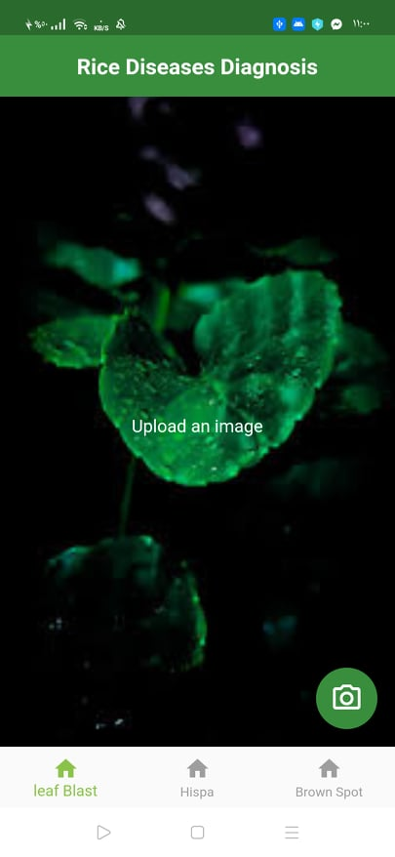
Choose the image from the gallery of previously captured images.
When uploading the image to the application, the application determines whether it is infected or not, and if it is infected, it will determine the name of this disease.

Slide 20
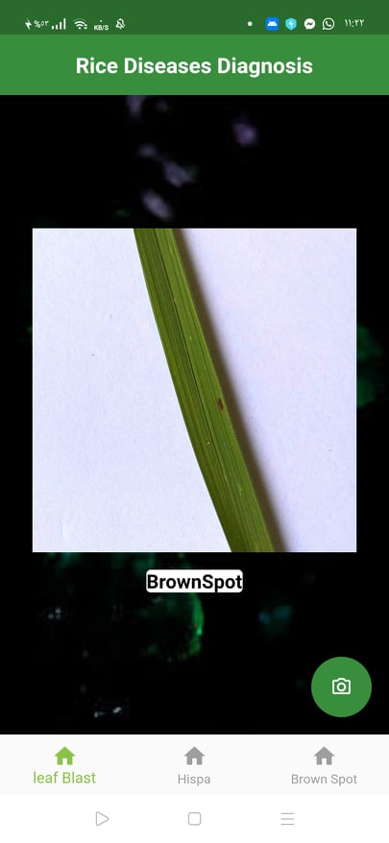
This picture represents BrownSpot disease that is one of the most important rice diseases.

Slide 21
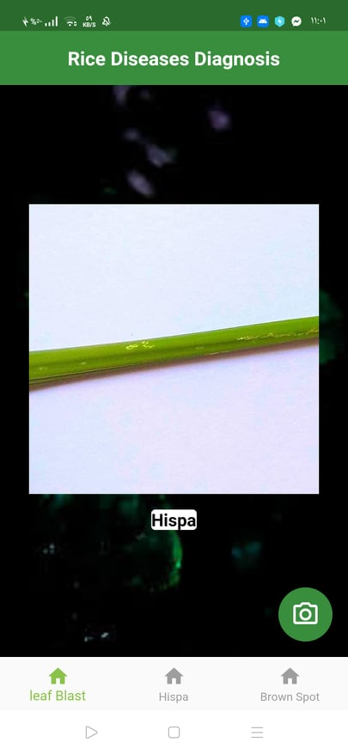
This picture represents Hispa disease that is one of the most important rice diseases.

Slide 22
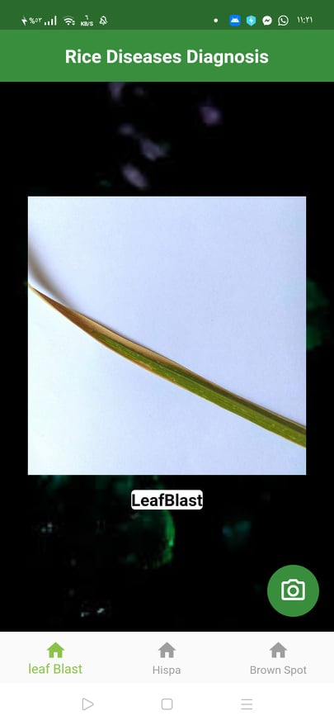
This picture represents LeafBlast disease that is one of the most important rice diseases.

Slide 23
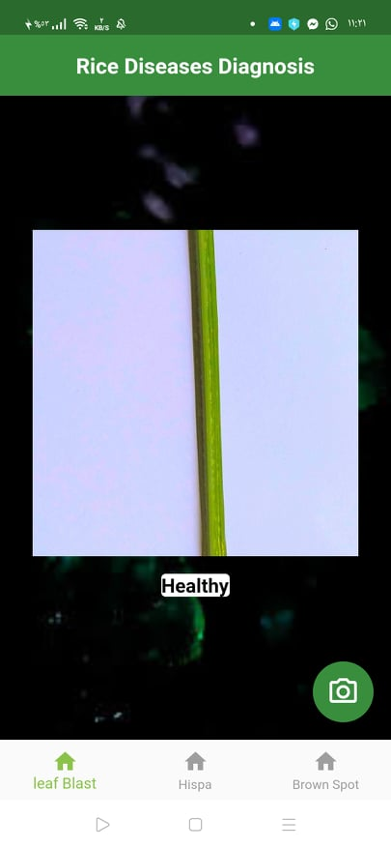
This picture represents Healthy leaf.

Slide 24
User can enter any page to know more about disease and its treatment.

Slide 25
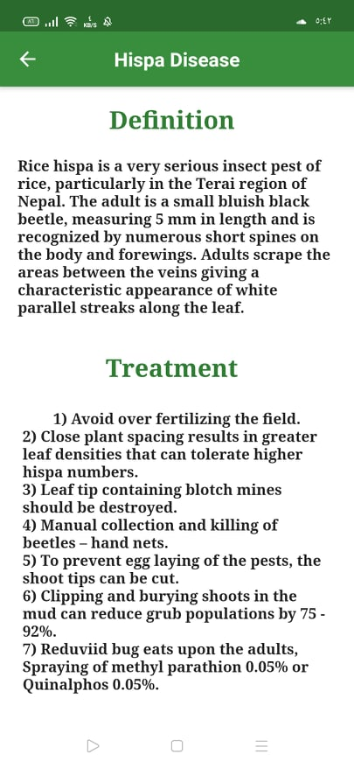
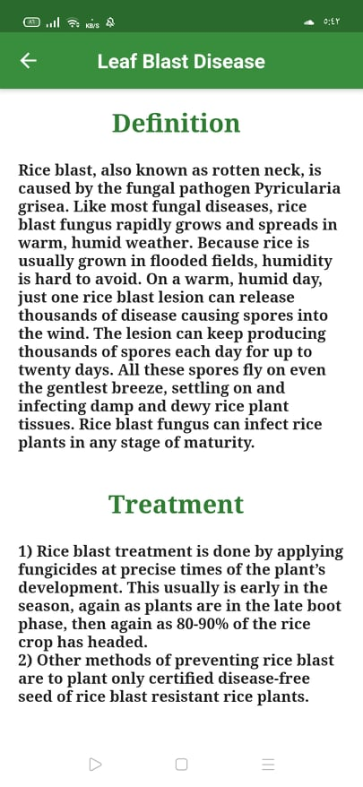
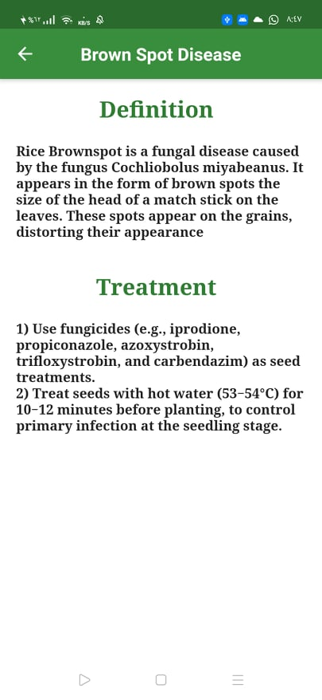

Slide 26
07 Future Work
1. We have added the common diseases that severely affect the productivity of the land plant and affect the national income, so we will seek in the future to add more other types of diseases that are not common to the rice plant, even if they affect slightly for the sake of the integrated application.
2. We also seek to provide data for most other diseases and treat them through the application to know the most diseases that affect the cultivation of the farmer and help him avoid those diseases and provide treatment methods for him in a simple way through our application.
3. It is likely to increase the spread of the application we will create a version of it available on the web (web app) and a version on the desktop (desktop app).
4. We will continuously develop the application design and internal updates to extend its life and continuity.
5. Also, the continuous development of treatment methods so that the farmer can keep pace with what is modern in the field of treating diseases.
6. Finally, we will strive to increase the efficiency of the model as much as possible.

Slide 27
Thank you

